Slide 1



CS Bridge, Lecture 3 More Karel Control Flow

Slide 2
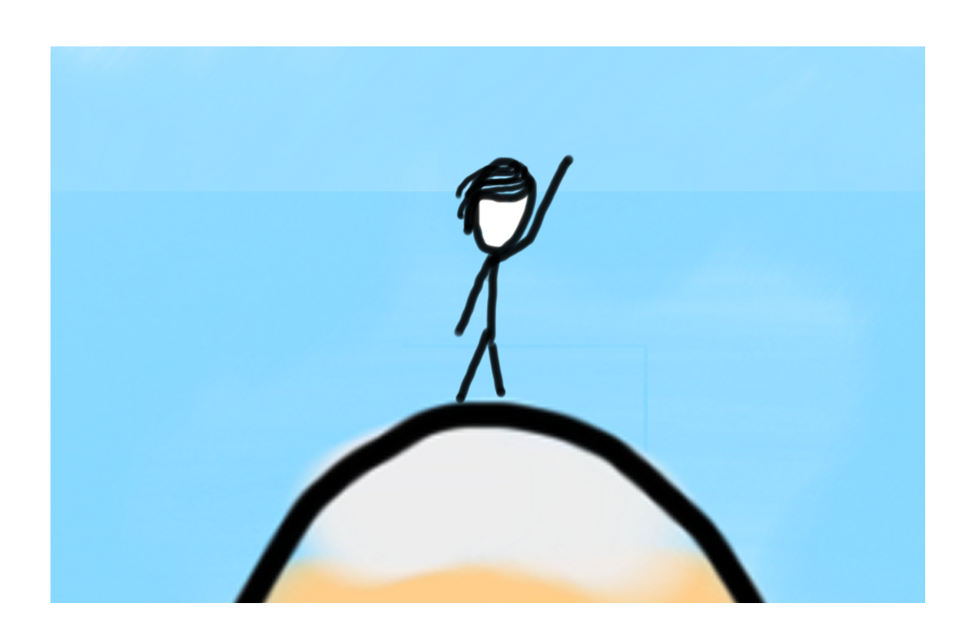

Learning Goals
Code using conditions
Trace programs that use loops and conditions
Decomposition

Slide 3

Lecture Plan
Review: Karel + Control flow
if/else statements
Decomposition and Top-Down Design
Practice: Hurdle Jumper

Slide 4
Lecture Plan
Review: Karel + Control flow
if/else statements
Decomposition and Top-Down Design
Practice: Hurdle Jumper

Slide 5
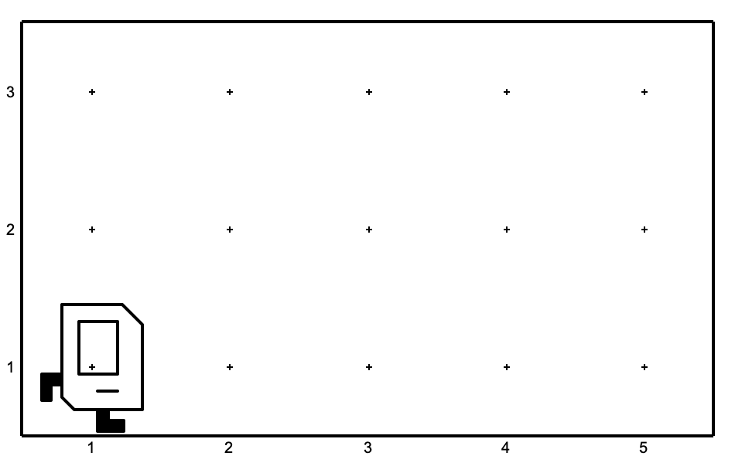
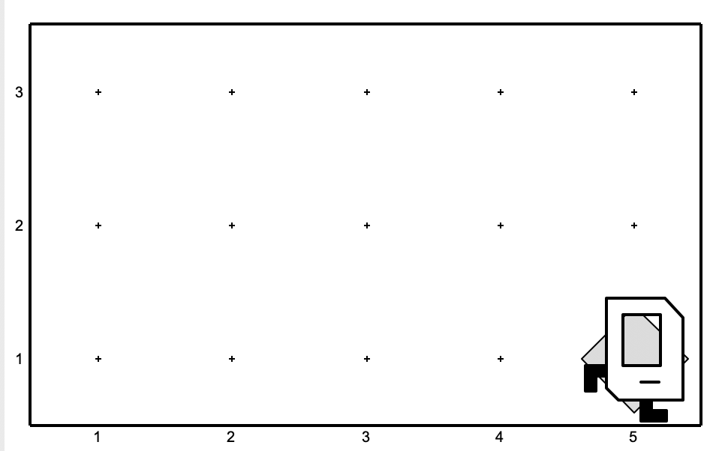
A quick question!
Which code will result in the following world?
def main():
while front_is_clear():
move()
put_beeper()
def main():
while front_is_clear():
move()
put_beeper()
(A)
(B)
Notes:
Karel – from Karel Chopek, who invented the word “robot”
Old Mac with leg out its back

Slide 6
Indentation
Karel is very picky about indentation.
Make sure to indent a code block 1 level further when you:
Define a new Karel command
Write a for loop
Write a while loop
You may nest these. Make sure you keep track of your indentation!

Slide 7
Control Flow
Control Flow lets us control the “flow” of our Karel program.
Example: repeat something 5 times
Example: repeat something until Karel is blocked

Slide 8
Control flow: For Loops
To repeat a block of code some number of times, we can use a for loop
for i in range(count):
statement1
statement2
...
Repeats the statements in the block count times.
Notes:
Executes statements in order – NOT repeating each one individually

Slide 9
Control Flow: While Loops
while condition:
statement
statement
...
Repeats the statements in the body until condition is no longer true.
Each time, Karel executes all statements, and then checks the condition.
Notes:
Karel can ask some questions about its world / surroundings

Slide 10
Conditions
Test | Opposite | What it checks
front_is_clear() | front_is_blocked() | Is there a wall in front of Karel?
left_is_clear() | left_is_blocked() | Is there a wall to Karel’s left?
right_is_clear() | right_is_blocked() | Is there a wall to Karel’s right?
beepers_present() | no_beepers_present() | Are there beepers on this corner?
facing_north() | not_facing_north() | Is Karel facing north?
facing_east() | not_facing_east() | Is Karel facing east?
facing_south() | not_facing_south() | Is Karel facing south?
facing_west() | not_facing_west() | Is Karel facing west?
Notes:
Executes statements in order – NOT repeating each one individually

Slide 11
Loops Overview
I want Karel to repeat some commands!
Know how many times
Don’t know how many times
for loop
while loop
Notes:
E.g. “pick up all the beepers on this square”
E.g. “turn until you’re facing west”
E.g. “put down 5 beepers”

Slide 12

Fencepost
I want Karel to put down a row of beepers until it reaches a wall. How do I do this?
Let’s first pretend the program must only work for this world. What commands should Karel execute?

Slide 13

Fencepost
I want Karel to put down a row of beepers until it reaches a wall. How do I do this?
put_beeper()
move()
put_beeper()
move()
put_beeper()
move()
put_beeper()

Slide 14
Fencepost
I want Karel to put down a row of beepers until it reaches a wall. How do I do this?
put_beeper()
move()
put_beeper()
move()
put_beeper()
move()
put_beeper()
We must put 4 beepers but move 3 times!

Slide 15

Fencepost Problem
8 fence segments, but 9 posts!

Slide 16
Fencepost Structure
The fencepost structure is useful when you want to loop a set of statements but do one part of that set 1 additional time.
put_beeper() # post
while front_is_clear():
move() # fence
put_beeper() # post
# or...
while front_is_clear():
put_beeper() # post
move() # fence
put_beeper() # post

Slide 17
Lecture Plan
Review: Karel + Control flow
if/else statements
Decomposition and Top-Down Design
Practice: Hurdle Jumper

Slide 18
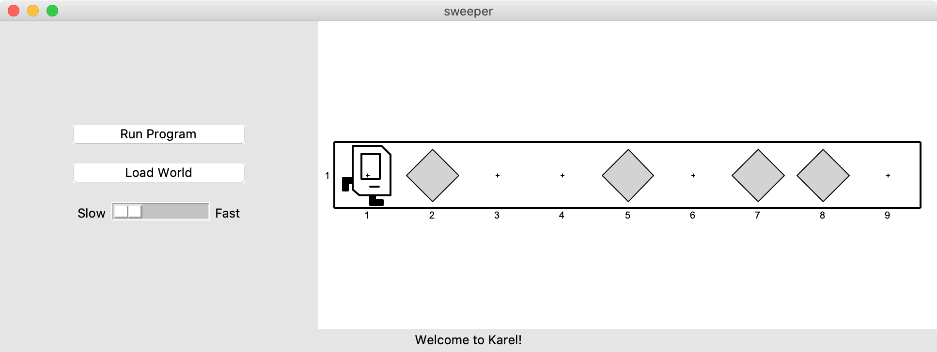
If Statements
I want to make Karel clean up all beepers in front of it until it reaches a wall. How do I do this?

Slide 19
If Statements
Will this work?
while front_is_clear():
move()
pick_beeper()
No. This may crash, because Karel cannot pick up beepers if there aren’t any. We don’t always want Karel to pick up beepers; just when there is a beeper to pick up.

Slide 20
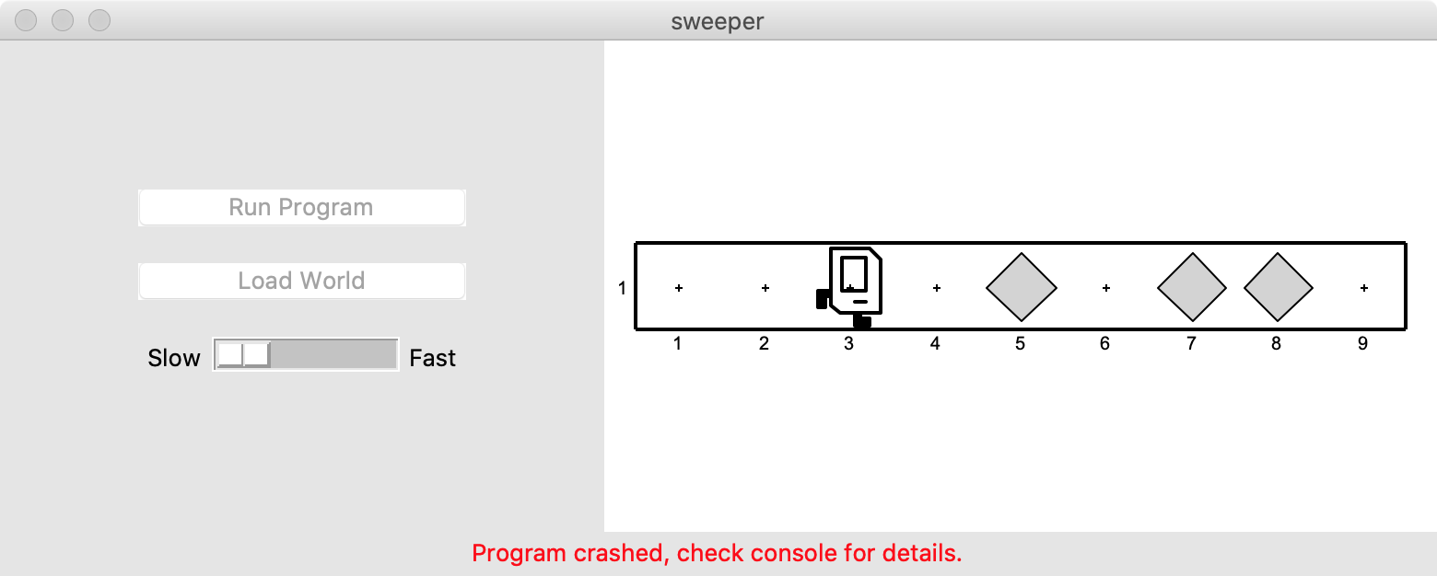

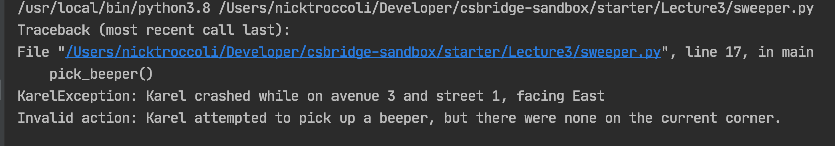
If Statements

Slide 21
If Statements
Instead, use an if statement:
if condition:
statement
statement
...
Runs the statements in the body once if condition is true. These are the same conditions you can use for while loops!
Notes:
Karel can ask some questions about its world / surroundings

Slide 22
If Statements
Instead, use an if statement:
if condition:
statement
statement
...
Runs the statements in the body once if condition is true. These are the same conditions you can use for while loops!
Notes:
Karel can ask some questions about its world / surroundings

Slide 23
If Statements
Now we can say:
while front_is_clear():
move()
if beepers_present():
pick_beeper()
Karel won’t crash because it will only pick up a beeper if there is one.

Slide 24
If Statements and Indentation
if condition:
statement
statement
statement # note indenting

Slide 25
If/Else Statements
What if we want to do one thing if some condition is true, and another otherwise? We can add an else statement:
if condition:
statement
statement
...
else:
statement
statement
...
This will run the first group of statements if condition is true; otherwise, it runs the second group of statements.

Slide 26
If/Else Statements
What does this code do?
def main():
if beepers_present():
pick_beeper()
else:
put_beeper()

Slide 27
If/Else Statements and Indentation
if condition:
statements # note indenting
else:
statements # note indenting
def invert_beepers():
if beepers_present():
pick_beeper() # note indenting
else:
put_beeper() # note indenting

Slide 28
Karel and Control Flow
Congratulations! You’ve learned all of control flow in Karel.
Control Flow lets us control the “flow” of our Karel program. For example, repeat something more than once, or only do something in certain cases.
Want to repeat something? Use a for or while loop.
- for if we know how many times
- while if we don’t know how many times
Want to conditionally do something? Use if (with an optional else)

Slide 29
Lecture Plan
Review: Karel + Control flow
if/else statements
Decomposition and Top-Down Design
Practice: Hurdle Jumper

Slide 30
Decomposition
When you start solving a problem, you should start by thinking about big tasks first.
E.g. You wake up and and trying to plan your day

Slide 31
Decomposition
When you start solving a problem, you should start by thinking about big tasks first.
E.g. You wake up and and trying to plan your day
Approach 1
Get left foot out of bed
Get right foot out of bed
Stand up
Move to washroom
Grab brush
Apply toothpaste
Brush teeth
Exit washroom
Go to kitchen
Crack eggs
…

Slide 32
Decomposition
When you start solving a problem, you should start by thinking about big tasks first.
E.g. You wake up and and trying to plan your day
Approach 1
Get left foot out of bed
Get right foot out of bed
Stand up
Move to washroom
Grab brush
Apply toothpaste
Brush teeth
Exit washroom
Go to kitchen
Crack eggs
…
Approach 2
Get out of bed
Wash up
Eat breakfast

Slide 33
Decomposition
When you start solving a problem, you should start by thinking about big tasks first.
E.g. You wake up and and trying to plan your day
Approach 1
Get left foot out of bed
Get right foot out of bed
Stand up
Move to washroom
Grab brush
Apply toothpaste
Brush teeth
Exit washroom
Go to kitchen
Crack eggs
…
Approach 2
Get out of bed
Exit bed
Stand up
Wash up
Eat breakfast

Slide 34
Decomposition
When you start solving a problem, you should start by thinking about big tasks first.
E.g. You wake up and and trying to plan your day
Approach 1
Get left foot out of bed
Get right foot out of bed
Stand up
Move to washroom
Grab brush
Apply toothpaste
Brush teeth
Exit washroom
Go to kitchen
Crack eggs
…
Approach 2
Get out of bed
Exit bed
Stand up
Wash up
Brush teeth
Wash face
Eat breakfast

Slide 35
Decomposition
When you start solving a problem, you should start by thinking about big tasks first.
E.g. You wake up and and trying to plan your day
Approach 1
Get left foot out of bed
Get right foot out of bed
Stand up
Move to washroom
Grab brush
Apply toothpaste
Brush teeth
Exit washroom
Go to kitchen
Crack eggs
…
Approach 2
Get out of bed
Exit bed
Stand up
Wash up
Brush teeth
Wash face
Eat breakfast
Make eggs
Pour juice
Eat

Slide 36
Decomposition
Breaking down problems into smaller, more approachable sub-problems (e.g. our own Karel commands)
Each piece should solve one problem/task (< ~ 20 lines of code)
Descriptively-named
Well-commented!
Problems should be solved top-down.

Slide 37
Top-Down Design
Start from a large task and break it up into smaller pieces
Ok to write your program in terms of commands that don’t exist yet
Goal: make our programs easily readable by humans
Commenting
Decomposition

Slide 38
Lecture Plan
Review: Karel + Control flow
if/else statements
Decomposition and Top-Down Design
Practice: Hurdle Jumper

Slide 39
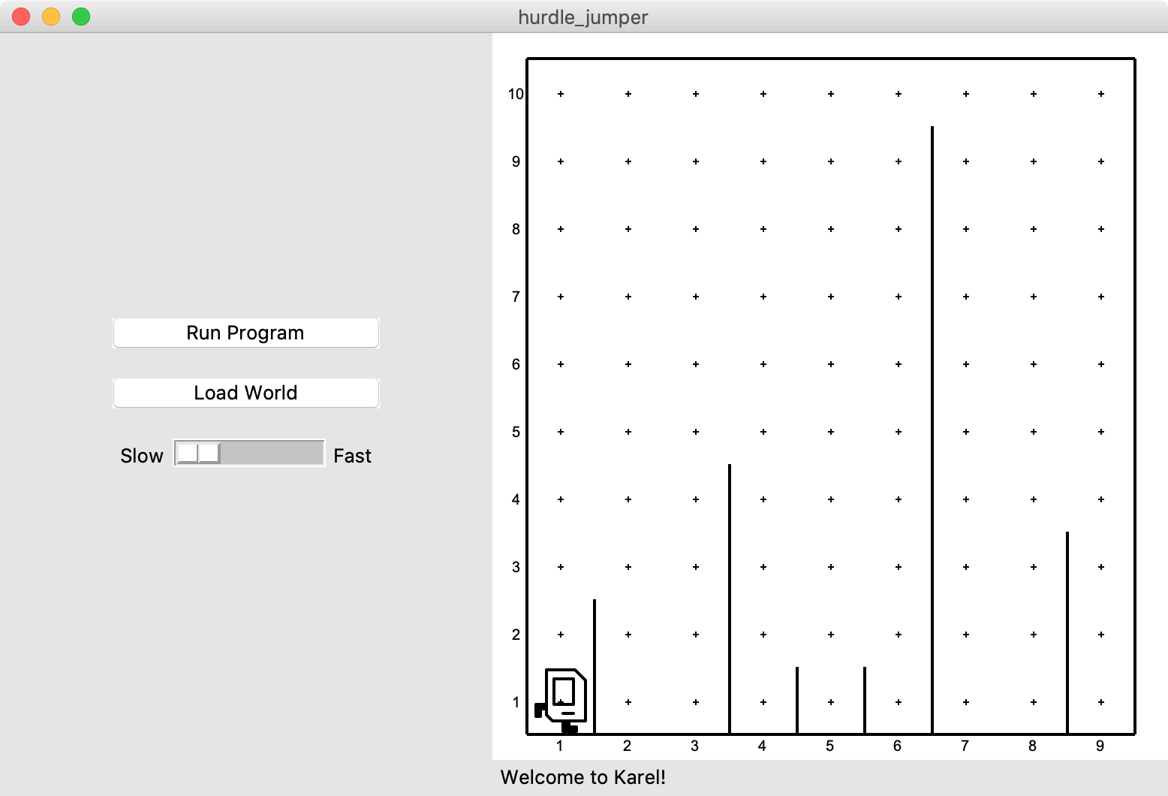
Hurdle Jumper
Karel is in the Olympics! We want to write a Karel program that hops hurdles.
Karel starts at (1,1) facing East and should end up at the end of row 1 facing east.
The world has 9 columns.
There are an unknown number of ”hurdles” (walls) of varying heights that Karel must ascend and descend to get to the other side.

Slide 40
Hurdle Jumper
Demo

Slide 41
Hurdle Jumper
Precondition: something you assume is true at the start of a function or code block
Postcondition: something you promise is true at the end of a function or code block
Pre/post-conditions should be documented using comments.
def jump_hurdle(): """ Karel jumps over one hurdle of arbitrary height. Pre-condition: Karel is facing east next to a hurdle. Post-condition: Karel is facing east at the bottom of the other side of the hurdle. """ ascend_hurdle() move() descend_hurdle()

Slide 42
Hurdle Jumper
Precondition: something you assume is true at the start of a function or code block
Postcondition: something you promise is true at the end of a function or code block
Pre/post-conditions should be documented using comments.
def main(): for i in range(8):
# What do we assume is true here?
if front_is_clear():
move()
else:
jump_hurdle()
# Does the postcondition match?

Slide 43

Karel Resources

Slide 44
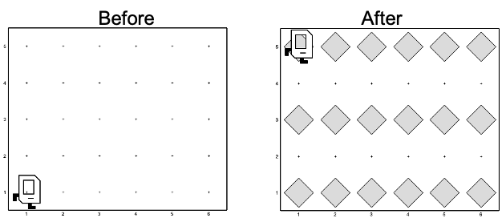
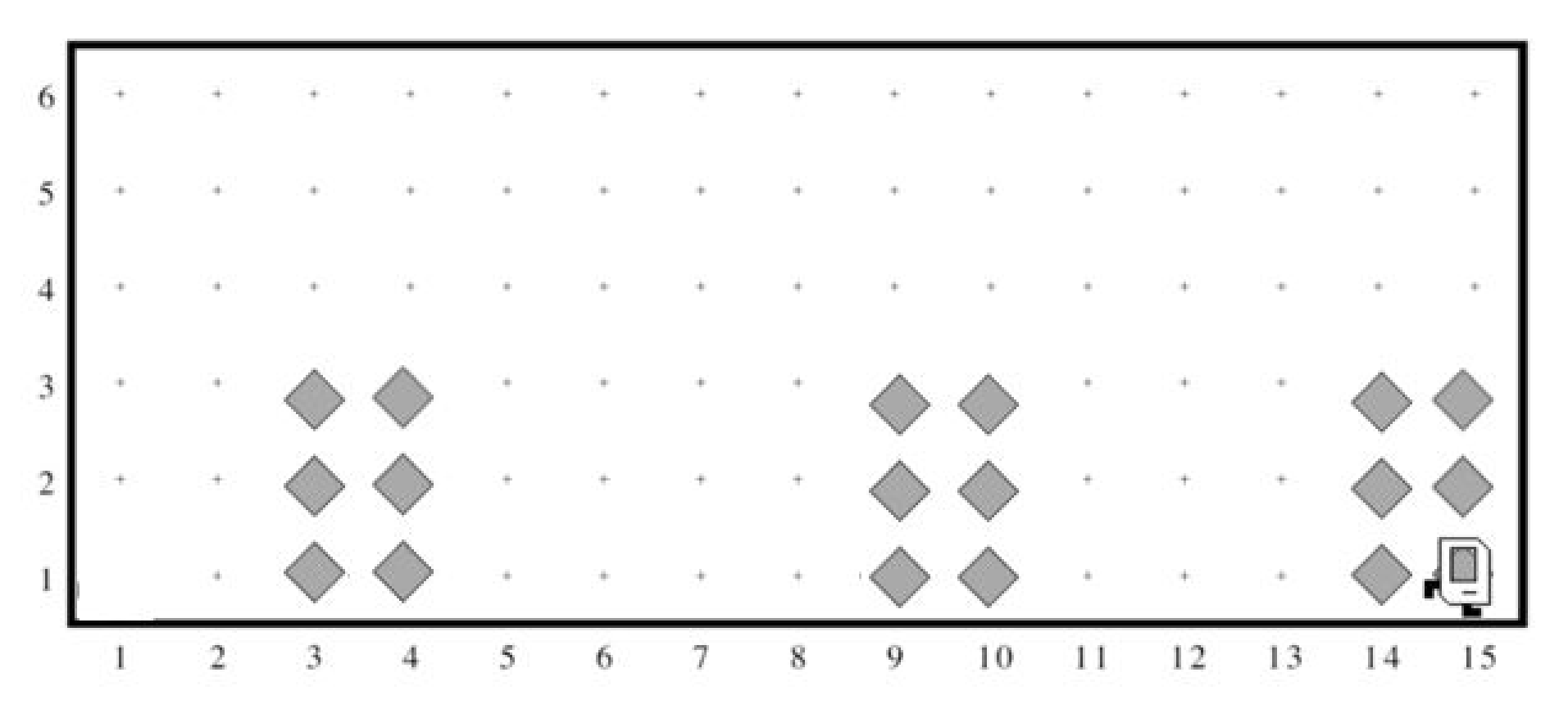
Rest Of Today
Quickstart: Implement a program where Karel draws stripes with Beepers.
Section: Implement a program where Karel builds Hospitals
Project: Write a program where Karel paints any world randomly with green and blue squares.

Slide 45
What’s Next?
Time for your section’s quickstart time!
Check your section’s Ed group for more information

